Slide 1
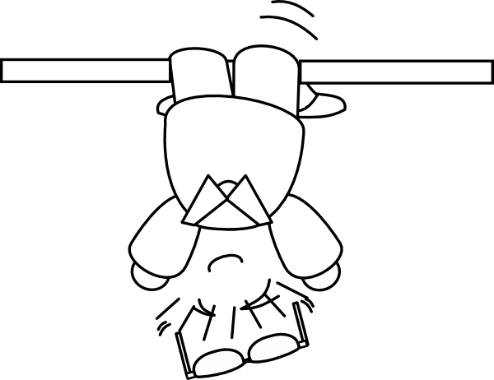
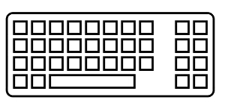
Coding backwards
in order to
to think straight
An initiation to
TDD
(Test Driven Development)

Slide 2
So, TDD …
… what is that?

Slide 3

It is a practice …
… a development one

Slide 4
It is a practice …
… a development one
It is not a testing practice:
Its purpose is to create production code
Test coverage is a welcome side-effect
It is but one of XP practices (which are complementary)
It is only a practice, not a silver bullet, not a dogma

Slide 5
RED
REFACTOR
GREEN

Slide 6
RED
Write a single test and watch it fail

Slide 7
RED
Write just enough code to make
the test pass
Write a single test and watch it fail
GREEN

Slide 8
RED
Write just enough code to make
the test pass
Write a single test and watch it fail
REFACTOR
GREEN
Improve the quality of the code, and also of the test

Slide 9
Consider the requirement
RED
Write just enough code to make
the test pass
Write a single test and watch it fail
REFACTOR
GREEN
Improve the quality of the code, and also of the test

Slide 10
Consider the requirement
RED
Write just enough code to make
the test pass
Write a single test and watch it fail
REFACTOR
GREEN
The main design effort occurs here
Improve the quality of the code, and also of the test

Slide 11
Okay, but …
… to what end?

Slide 12

Higher Quality

Slide 13
Higher Quality
Users and business satisfaction
Product relialibility and robusteness
Tolerance to change
Building trust and confidence
Continuous improvement cycle

Slide 14
Okay, but then …
... why is it so uncommon?

Slide 15

An Emerging Profession

Slide 16
An Emerging Profession
Very little hindsight on the different practices
School curricula are evolving... at their own pace
A high overall complexity of the variables involved

Slide 17

A « Magnifying » Effect

Slide 18
A « Magnifying » Effect
Colliding with existing code can be painful
Discovering problems: design, requirements, organization…
Accepting these problems and improving
Not blaming the practice for what it reveals

Slide 19

Easy from a distance...
... far from being easy

Slide 20
Easy from a distance...
... far from being easy
Changing work habits to learn TDD may actually feel like the “Backwards Brain Bicycle” experiment
Conforming to a constrained cycle can be frustrating
Understanding before coding is not that simple
Learning takes time, so there is a cost – and someone has to pay for this, but (usually) no one wants to

Slide 21
Let’s take a step back

Slide 22

Software is
eating the world

Slide 23
Software is
eating the world
Software is ubiquitous in our personal lives, our society, industry and government
The Fourth Industrial Revolution is upon us, bringing together digital, biological, and physical technologies
Technology becomes embedded within societies and even the human body

Slide 24
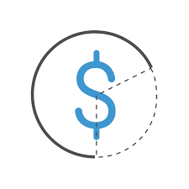
There seems
to be a cost

Slide 25
There seems
to be a cost
Legacy systems, massive failures and 9-digit defects, troubled and cancelled projects, technical debt…
The cost of poor quality software in the US in 2018 is approximately $2.26 trillion
About 60% of the US software engineering work time centers on finding and fixing errors

Slide 26

So, what can we do?

Slide 27
So, what can we do?
Find and fix problems and deficiencies as close to the source as possible
Prevent them from happening in the first place
High-quality software is faster and cheaper to build and maintain than low-quality software

Slide 28
Okay, but …
… how does TDD help in all this?

Slide 29

Hacking our brains

Slide 30
Hacking our brains
Evolution left us with many cognitive biases:
Too much information (eg. Confirmation Bias)
Limits of memory (eg. Testing Effect)
Lack of meaning (eg. Bandwagon Effect)
Acting in urgency (eg. Loss Aversion)

Slide 31

Hacking our brains
versus
Too much information

Slide 32
Hacking our brains
versus
Too much information
TDD is more fit to our attention span:
Feedback happening every few seconds
A framework to focus on
Milestones over time and progress

Slide 33

Hacking our brains
versus
Limits of memory

Slide 34
Hacking our brains
versus
Limits of memory
TDD helps with the learning process:
Trial and error
Repetition
Solution emergence
Continuous Improvment

Slide 35
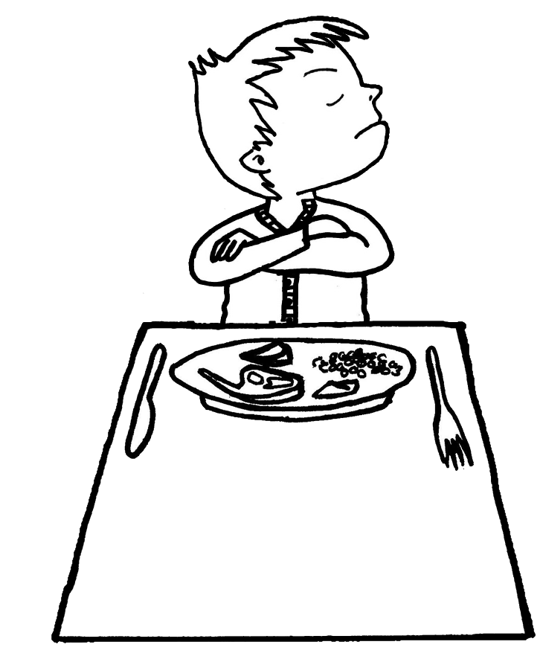
Hacking our brains
versus
Lack of meaning

Slide 36
Hacking our brains
versus
Lack of meaning
TDD acts as an operant conditioning process:
« Green » highlights each achievement
« Red » stresses incompleteness
Confidence increases with each cycle

Slide 37

Hacking our brains
versus
Acting in urgency

Slide 38
Hacking our brains
versus
Acting in urgency
TDD helps with our natural tendency to procrastinate:
TODO

Slide 39
Hacking our brains
versus
Acting in urgency
TDD helps with our natural tendency to procrastinate:
An iterative process, providing steps for progress
Tests cannot be forgotten or postponed

Slide 40
Let's get back to the point …
… TDD is therefore:

Slide 41
Consider the requirement
RED
Write just enough code to make
the test pass
Write a single test and watch it fail
REFACTOR
GREEN
The main design effort occurs here
Improve the quality of the code, and also of the test

Slide 42
Okay, but, speaking of design...
… what is good design?

Slide 43
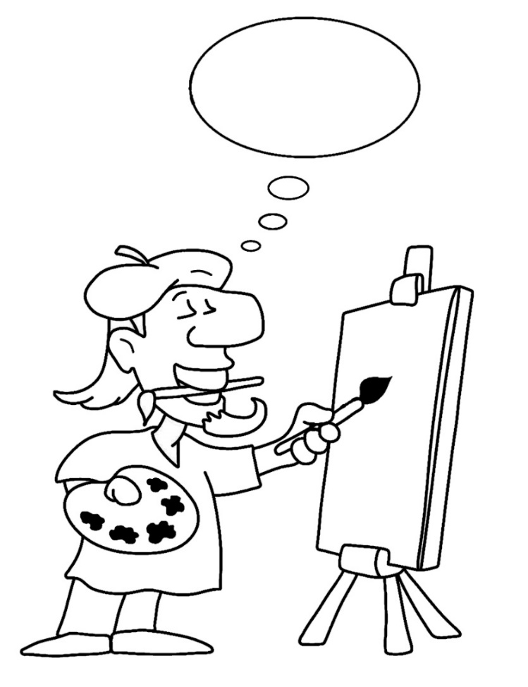
Three main
categories of Design

Slide 44
Three main
categories of Design
Architecture
Macro design
Micro design

Slide 45
Three main
categories of Design
Architecture
Macro design
Micro design
= infrastructure, persistence …
= packages, dependencies …
= business code, rules …

Slide 46
Three main
categories of Design
Architecture
Macro design
Micro design
= infrastructure, persistence …
= packages, dependencies …
= business code, rules …
TDD

Slide 47
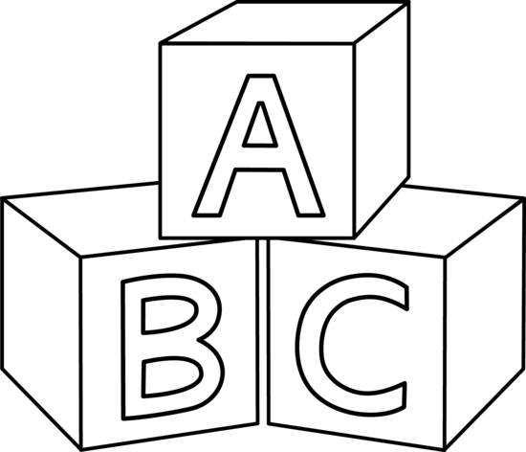
Four Rules
of Simple Design

Slide 48
Four Rules
of Simple Design
Passes the tests
Reveals intention
No duplication
Fewest elements

Slide 49
Four Rules
of Simple Design
Passes the tests
Reveals intention
No duplication
Fewest elements
+
Priority
-

Slide 50
Okay, but …
… that's not enough!

Slide 51

It's a long way to go

Slide 52
It's a long way to go
Design Patterns
SOLID Principles
Clean Code
Domain Driven Design
…

Slide 53
So …
… how do we get started ?

Slide 54

Some guidelines
for the TDD cycle

Slide 55
Some guidelines
for the TDD cycle
Add one (and only one) new test while in « Green »
Watch the test fail before coding a solution to make it pass
Code in order to return as soon as possible to « Green »
Refactor code or test at any one time, not both

Slide 56
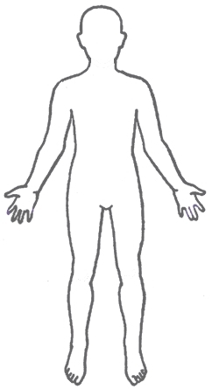
Anatomy of a Test

Slide 57
Anatomy of a Test
GIVEN
WHEN
THEN

Slide 58
Anatomy of a Test
GIVEN
WHEN
THEN
Context
Event
Expectation

Slide 59
Anatomy of a Test
GIVEN
WHEN
THEN
Context
Event
Expectation
= states / data
= what is being tested
= solution to the requirement

Slide 60
Anatomy of a Test
3
GIVEN
WHEN
THEN
Context
Event
Expectation
= states / data
= what is being tested
= solution to the requirement
2
1

Slide 61
Consider the requirement
RED
Write just enough code to make
the test pass
Write a single test and watch it fail
REFACTOR
GREEN
The main design effort occurs here
Improve the quality of the code, and also of the test

Slide 62
In the end, the key is ...
… practising!

Slide 63
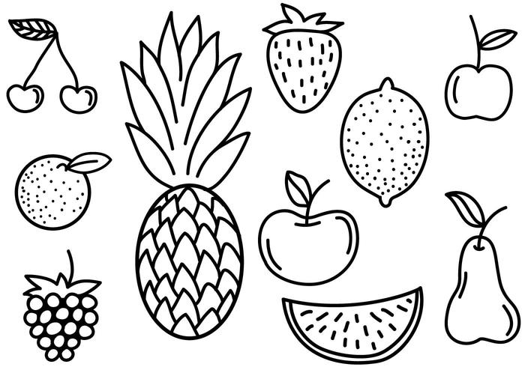
Fruit Shop
Charge the right amount when the customer goes to the checkout.
Business rules (prices in cents):
1 apple costs 100
1 banana costs 150
1 cherry costs 75

Slide 64
A first simple test
@Test public void noCheckoutForEmptyCart() { }

Slide 65
A first simple test
@Test public void noCheckoutForEmptyCart() { // THEN assertThat(totalAmount).isEqualTo(0); }

Slide 66
A first simple test
@Test public void noCheckoutForEmptyCart() { // WHEN int totalAmount = cart.computeTotalAmount(); // THEN assertThat(totalAmount).isEqualTo(0); }

Slide 67
A first simple test
@Test public void noCheckoutForEmptyCart() { // GIVEN Cart cart = new Cart(); // WHEN int totalAmount = cart.computeTotalAmount(); // THEN assertThat(totalAmount).isEqualTo(0); }

Slide 68
Fruit Shop
Charge the right amount when the customer goes to the checkout.
Business rules (prices in cents):
1 apple costs 100
1 banana costs 150
1 cherry costs 75

Slide 69
Fruit Shop
Charge the right amount when the customer goes to the checkout.
Business rules (prices in cents):
1 apple costs 100
1 free apple when two bought apples
1 banana costs 150
1 cherry costs 75

Slide 70
Fruit Shop
Charge the right amount when the customer goes to the checkout.
Business rules (prices in cents):
1 apple costs 100
1 free apple when two bought apples
1 banana costs 150
1 cherry costs 75
You have to be able to sell « des pommes » in France

Slide 71
Fruit Shop
Charge the right amount when the customer goes to the checkout.
Business rules (prices in cents):
1 apple costs 100
1 free apple when two bought apples
1 banana costs 150
The second banana is half price
1 cherry costs 75

Slide 72
Fruit Shop
Charge the right amount when the customer goes to the checkout.
Business rules (prices in cents):
1 apple costs 100
1 free apple when two bought apples
1 banana costs 150
The second banana is half price
1 cherry costs 75
A loyalty program customer is entitled to a 10% discount

Slide 73


